Slide 1
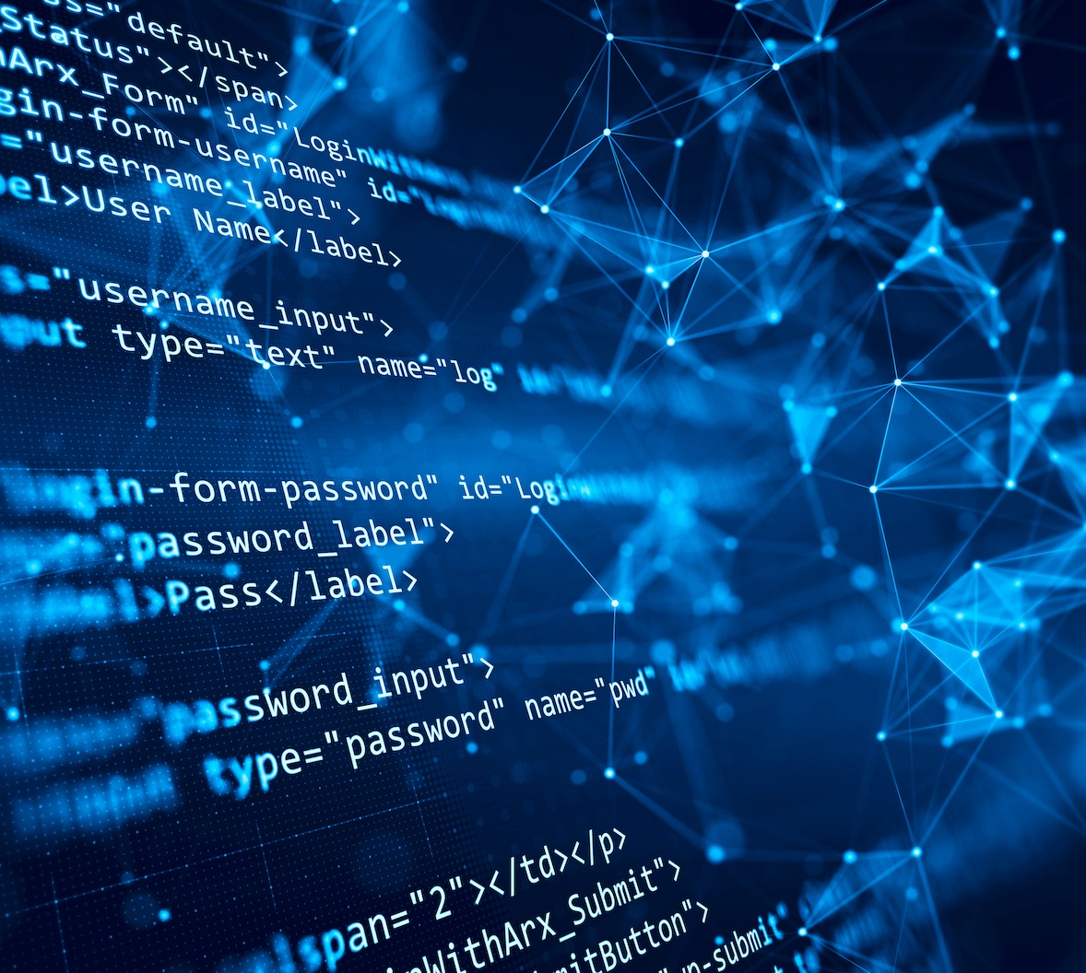

Team 55: Research Lab
Inventory Tracker
Bi-Weekly Update 3 Lizzett Tapia Sumedha Bhattacharyaa Jonathan Moore Evan Ross TA: Niloofar Borzooei
Notes:
Michelle

Slide 2
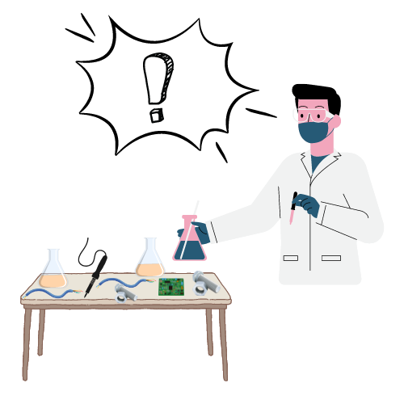
Problem Statement
“The current lab inventory tracking systems at Texas A&M are inefficient, and it is necessary to create new, organized software to increase the overall performance and efficiency of the Lab.”

Slide 3
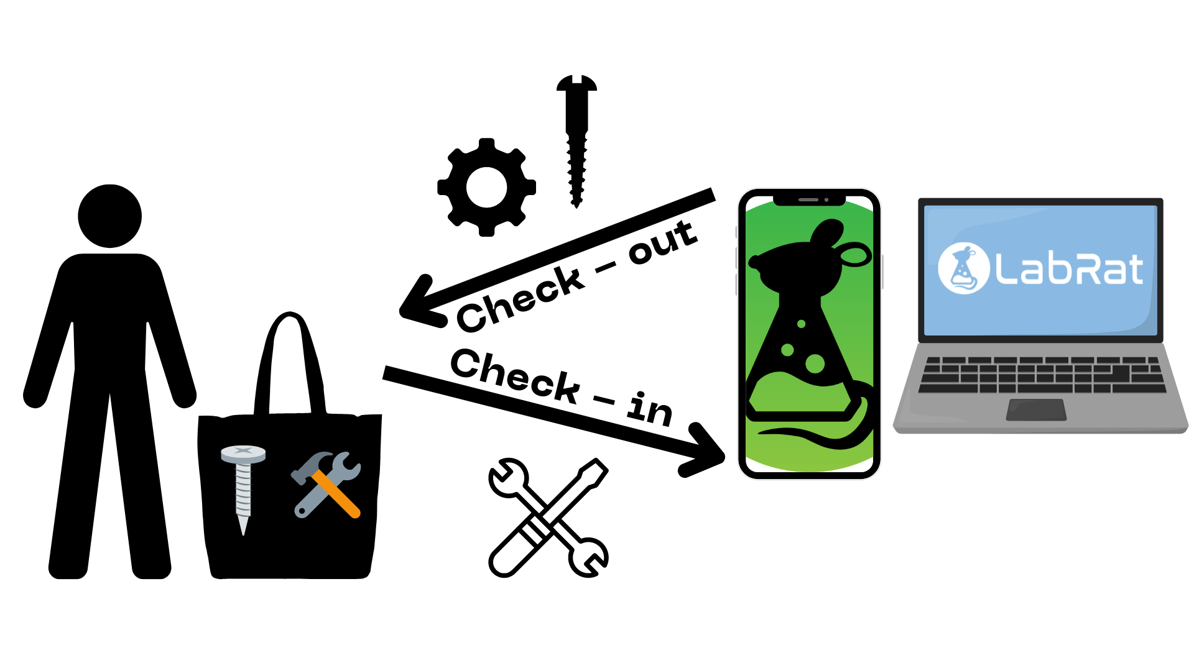
Solution Proposal
“Develop a web and mobile application integrated with a database to streamline inventory management in TAMU labs. The mobile app uses a machine learning-based image classification system to allow users to easily check items in and out by scanning them.”

Slide 4
Interaction of Subsystems
Database
Web-App
Mobile App
Machine Learning Model
Jonathan Lizzett Sumedha Evan

Slide 5
Project Timeline
Subsystem Designs and Testing (completed 1/27) | Integration preparation of server with website and mobile app (completed 2/3) | Integration of ML model with mobile application (to complete by 2/27) | Final Integration (to complete by 3/3) | System Test (to complete by 3/24) | Validation (to complete by 4/14) | Demo and Report (to complete by 4/21 and 4/28 respectively)

Slide 6
Android App
Accomplishments since last update 14 hrs of effort | Ongoing progress/problems and plans until the next presentation
Linking to External Database users and items table completed Encrypt/Decrypt passwords Linked to backed and ML model | Redesign app pages to use information given by ML Link app to orders and checkout table of database

Slide 7

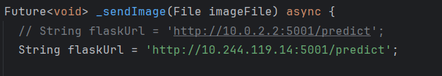
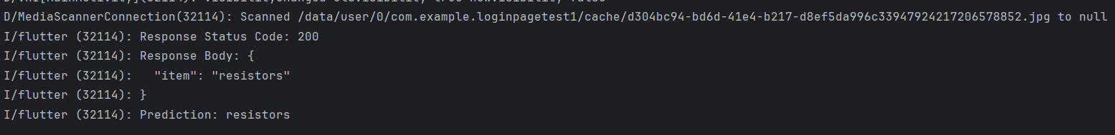
Android App

Slide 8
Database Server
Accomplishments since last update 13 hrs of effort | Ongoing progress/problems and plans until the next presentation
Completed integration with website and mobile app Completed user input testing between server, website, and mobile app | Ongoing functional testing of mobile application and server

Slide 9
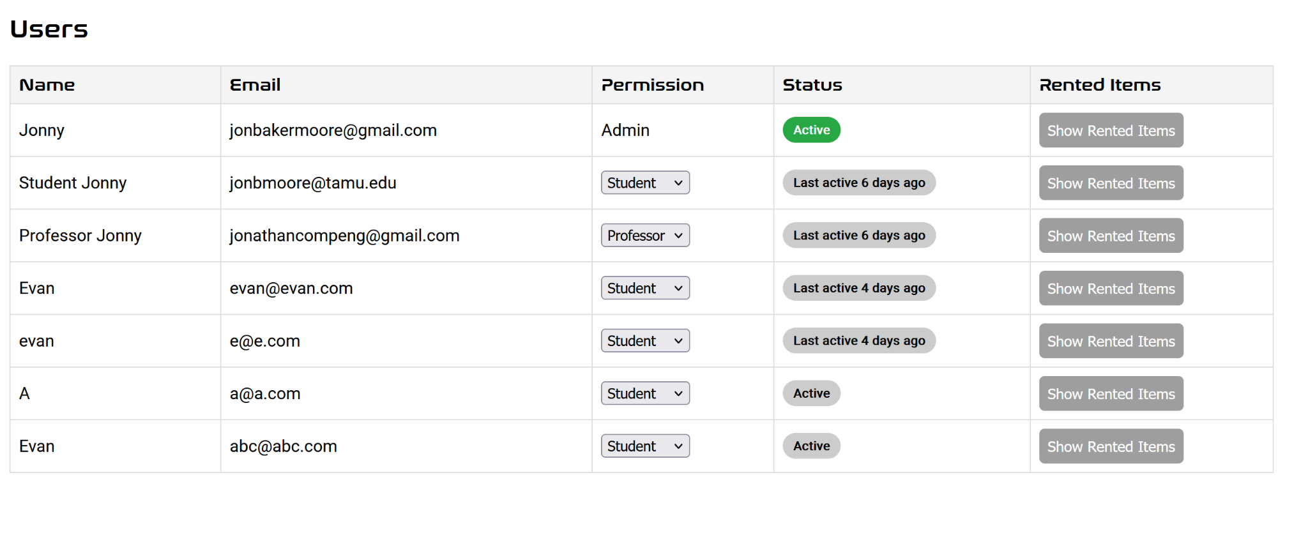
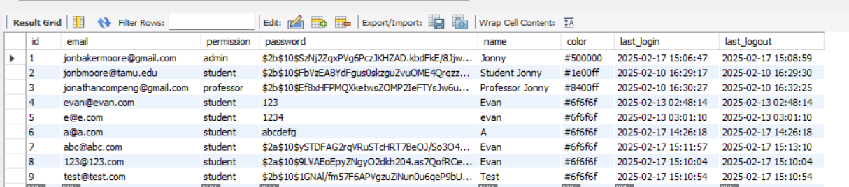
Database Server

Slide 10
Machine Learning Model
Accomplishments since last update 15 hrs of effort | Ongoing progress/problems and plans until the next presentation
Built a server using Flask to host the Machine Learning Model (.pth and load file) Completed Integration of Model into the server Completed integration of server (ie. ML Model) with the Mobile App | Ongoing functional testing of ML Model with Mobile App

Slide 11
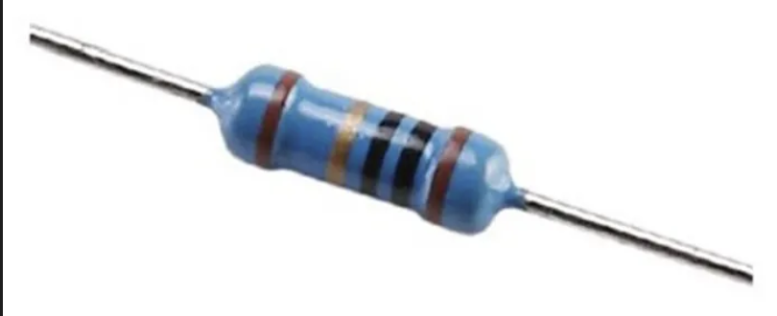
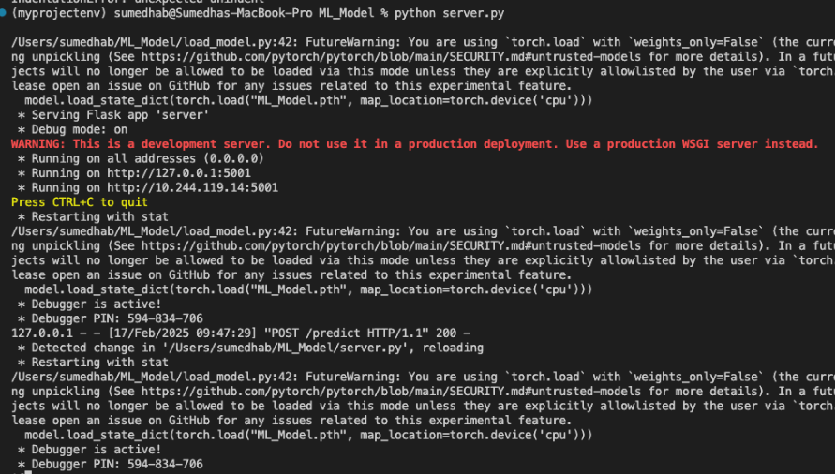


Slide 12
Website
Accomplishments since last update 15 hrs of effort | Ongoing progress/problems and plans until the next presentation
Completed integration with database | Continuing parity with the mobile application Validation ongoing as well

Slide 13
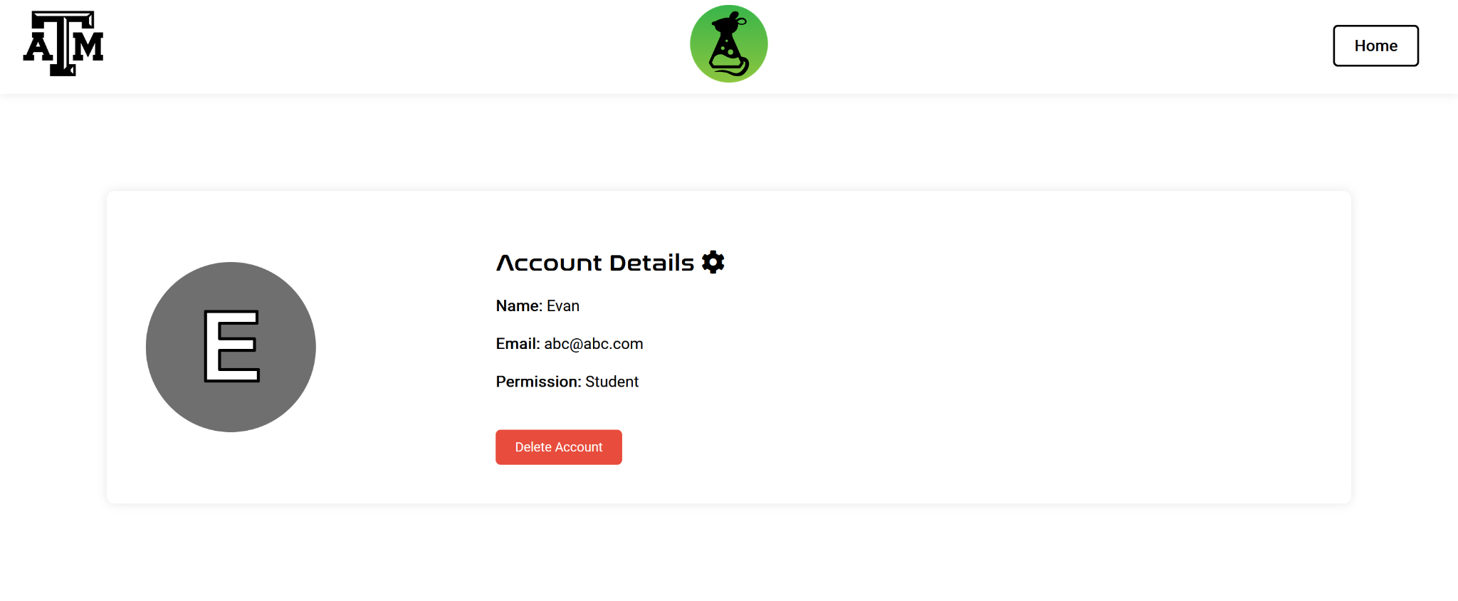
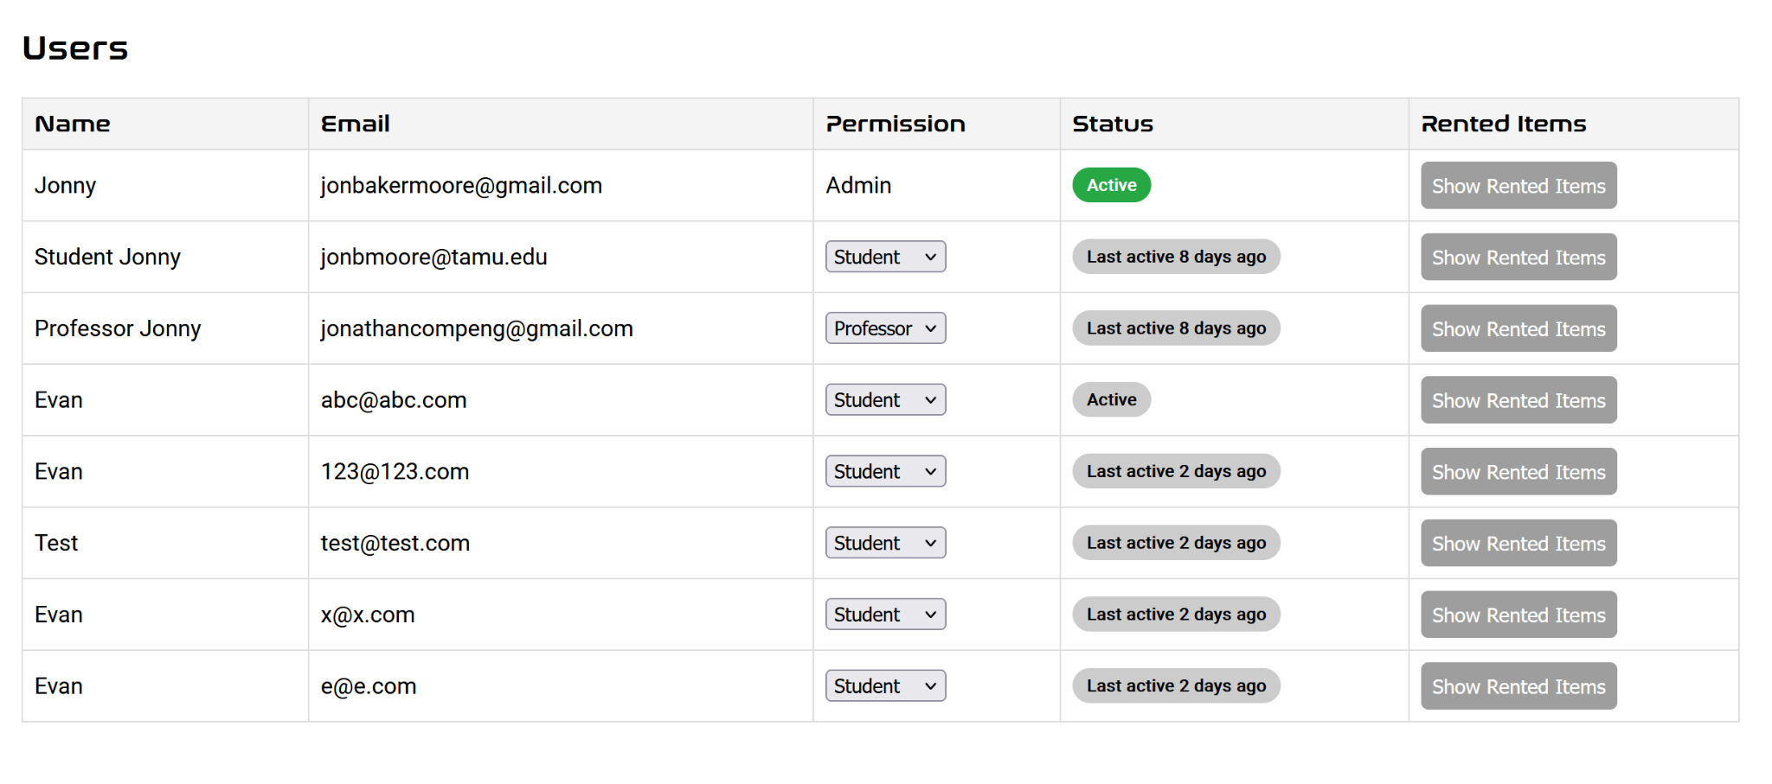

Slide 14
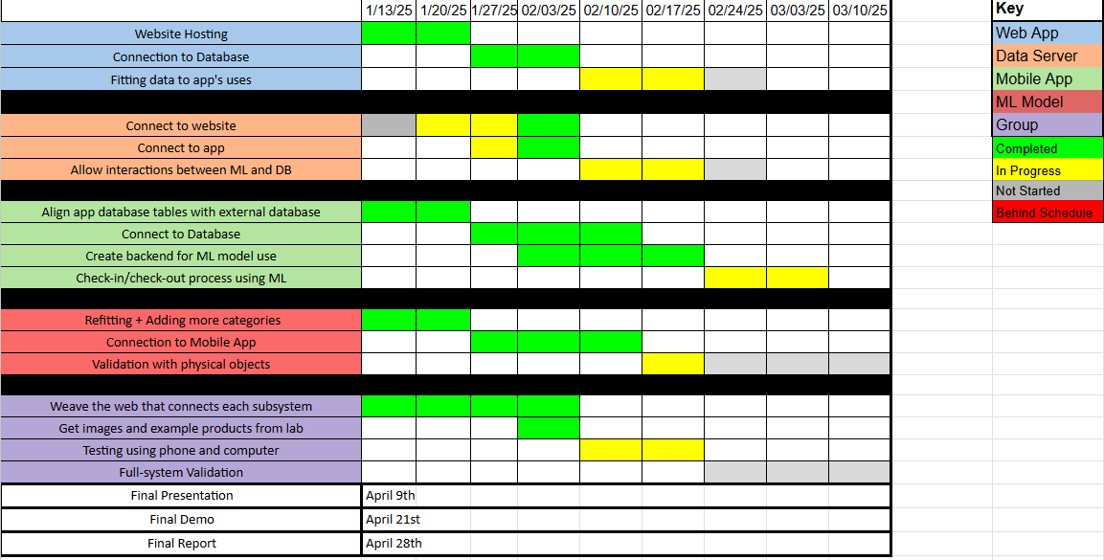
Execution Plan

Slide 15
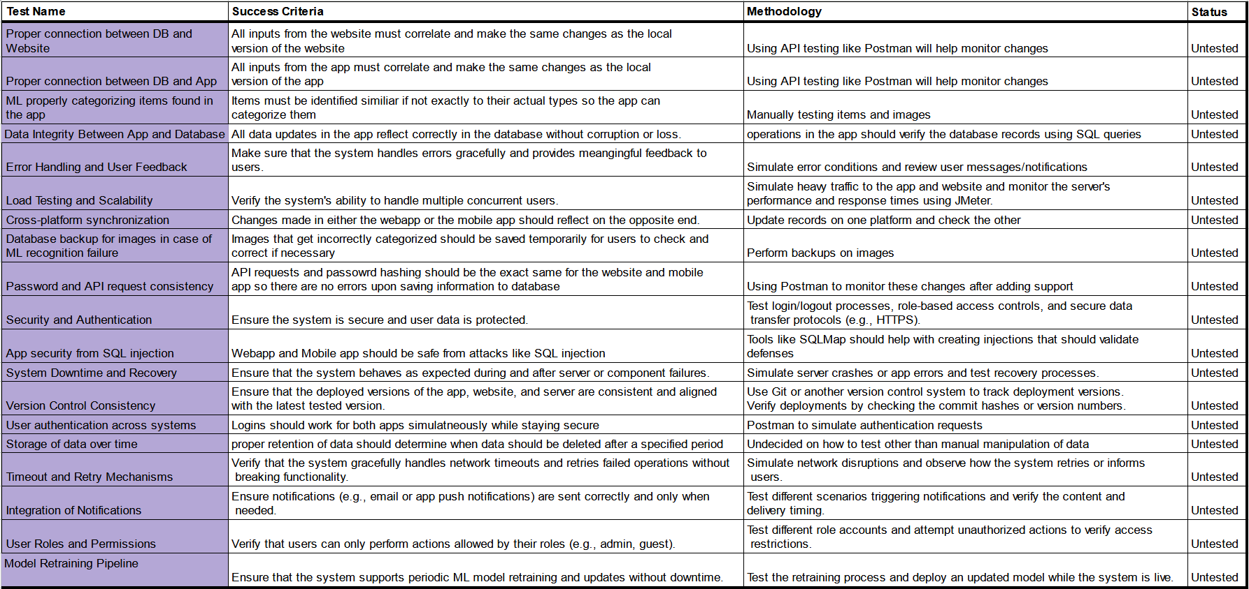
Validation Plan
Notes:
Michelle

Slide 16
Thank You For Listening!

